Slide 1
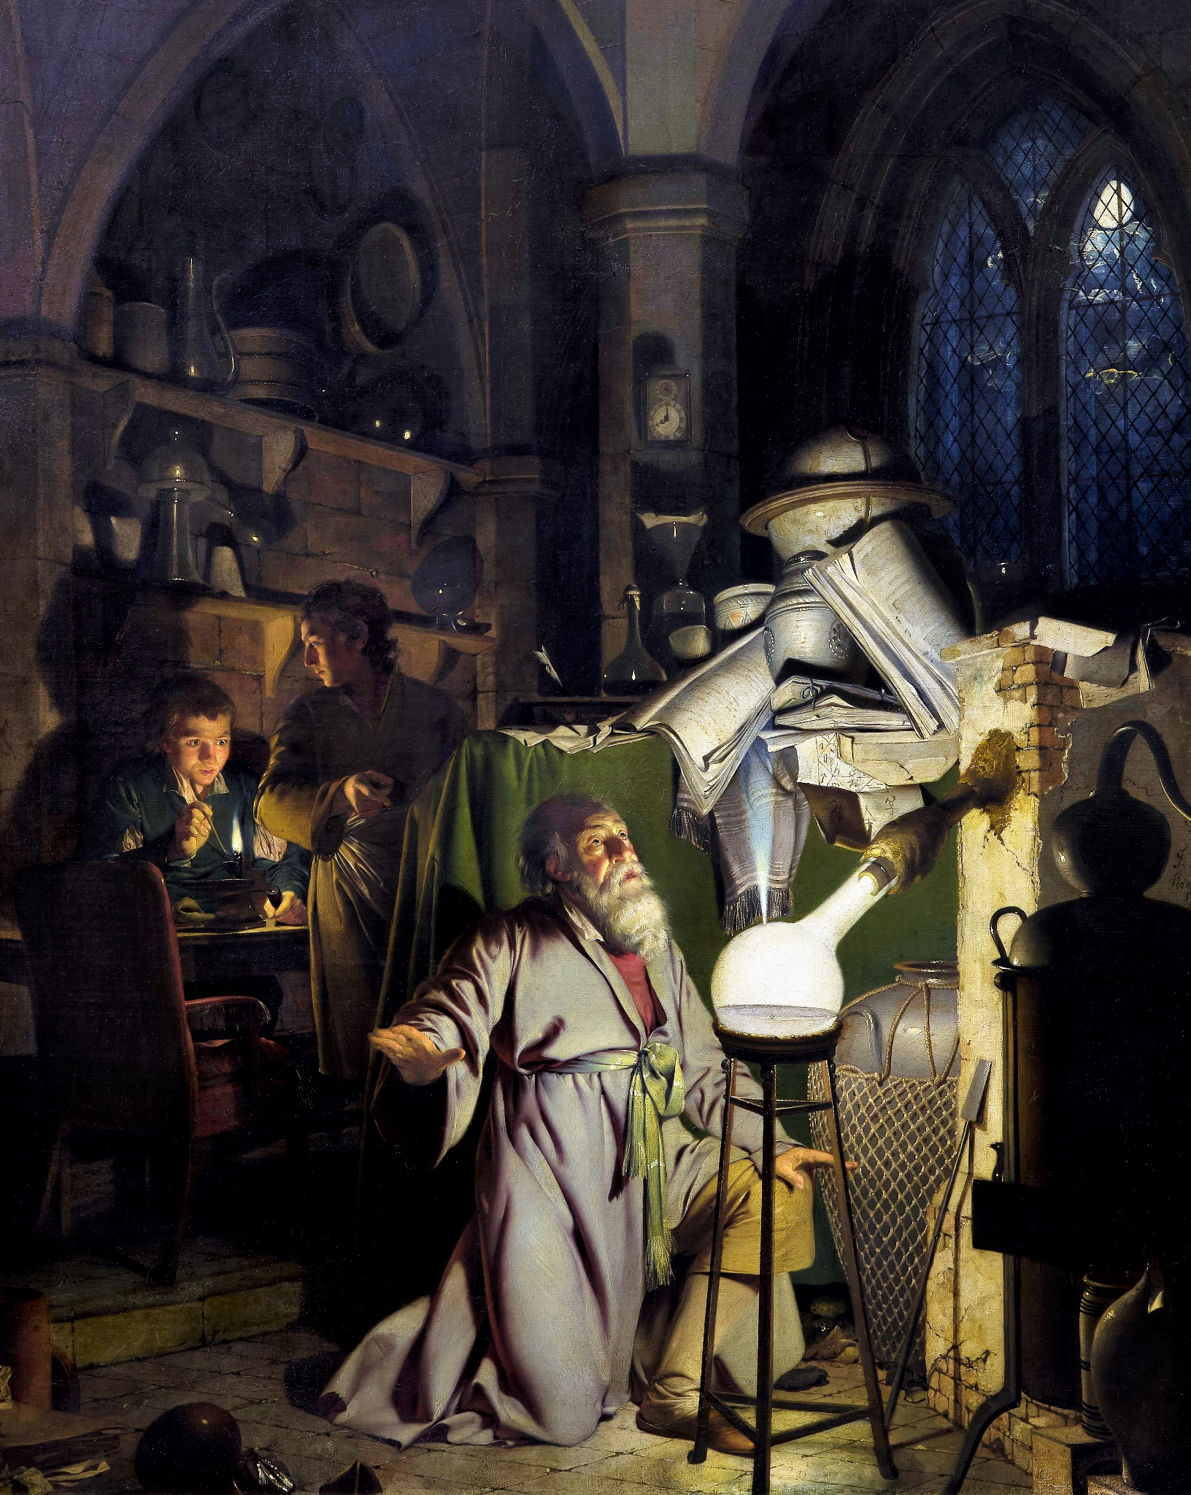

Dissemination 2: How (not) to show off
IL "Scientific Method and Analysis" WS 24-25
Kami Höferl
(Wright of Derby, Wikimedia, PD)
Notes:
"The Alchemist in Search of the Philosopher's Stone" by Joseph Wright of Derby (1771)
substance capable of turning base metals such as mercury into gold or silver[
In this work, Wright captures an alchemist conducting an experiment with a crucible in search of the philosopher's stone. The painting portrays a moment of discovery and highlights the experimental process central to early chemistry, before the formalisation of modern science.

Slide 2
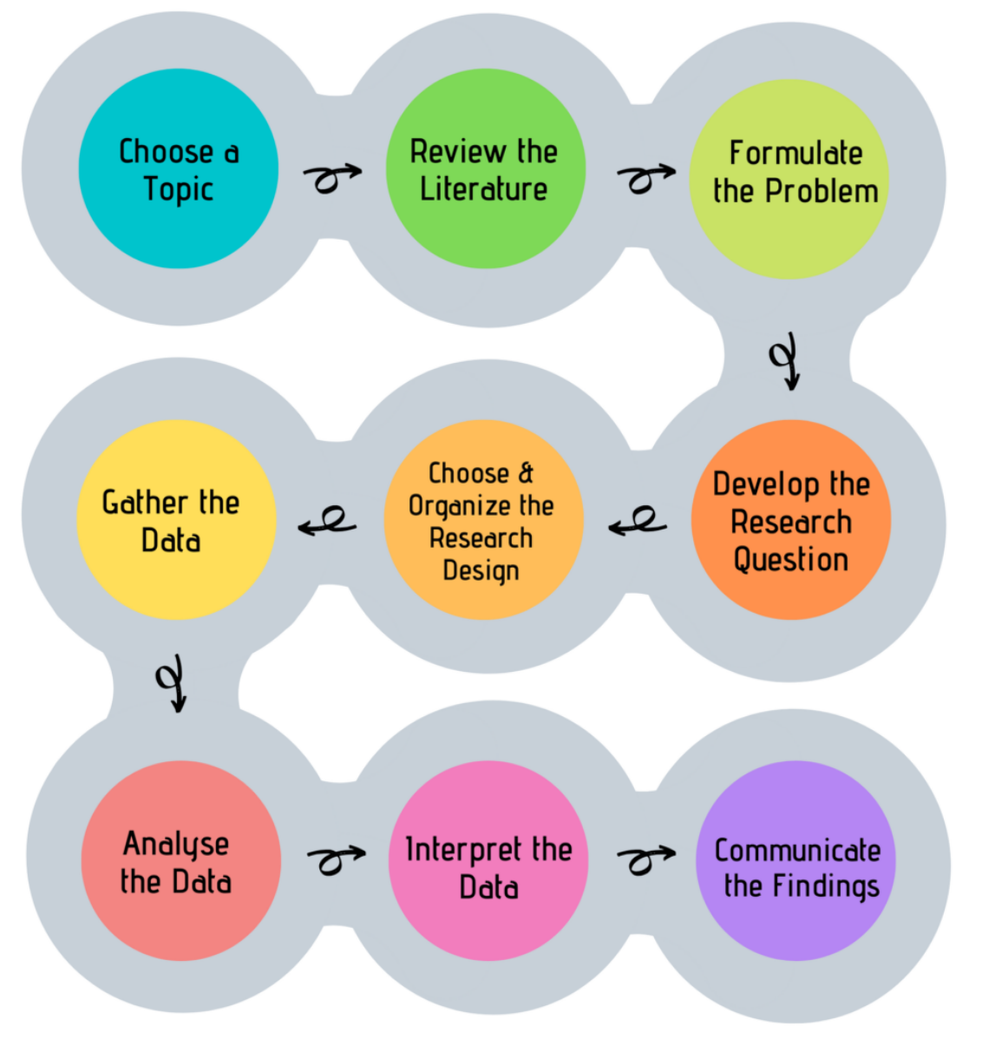
Look, Think, Test, Tell
(Sheppard, 2020:5)

Slide 3
How to Communicate your Findings?
🤔

Slide 4


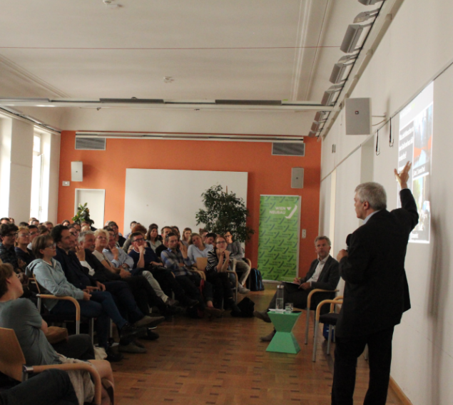
... Presentation of Findings I

Slide 5
Preparing a talk

Slide 6
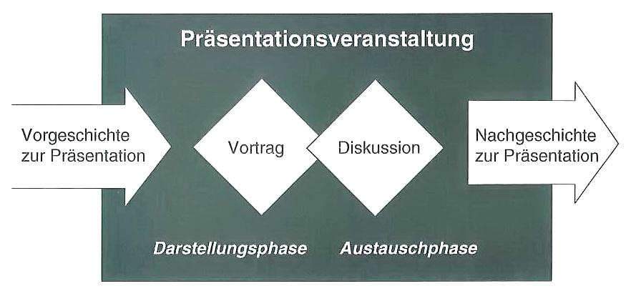
Preparing, Delivering and Digesting a Talk
1
2
3
4
Preparation of the presentation
(Lehmann 2007:134)

Slide 7
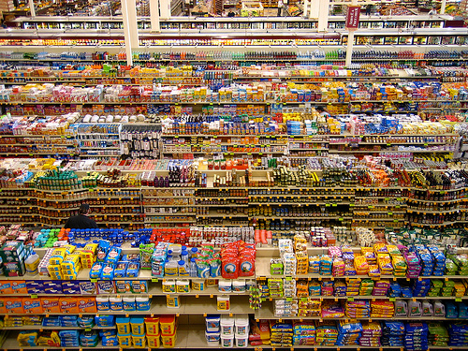
1. Prepare Presentations: What do I want to say?
Target audience?
The aim of the talk?
Inform
Overview
Discussion of own results
Suggestions for open questions
The main message?
General conditions?
Time frame → Time discipline
Space & infrastructure
Notes:
Present = Select

Slide 8
The Content ... should be Organised
Topic
Research objective & questions
Aim of the lecture
Procedure/structure
Current reference
Main part
Introduction
Conclusion

Slide 9
The Content ... should be Organised
Topic
Research objective & questions
Aim of the lecture
Basics & Argumentation
State of research
Methods
Procedure/structure
Current reference
Results
Main part
Introduction
Conclusion

Slide 10
The Content ... should be Organised
Topic
Research objective & questions
Aim of the lecture
Basics & Argumentation
State of research
Methods
Procedure/structure
Outlook
Current reference
Summary → Key messages
Results
Main part
Introduction
Conclusion

Slide 11
The Introduction
... arouse interest 👉 connections
Current events, facts & figures
Personal experiences
Scientific results
Quotes
... emphasise benefits
What topics does the lecture contribute to?
Benefits for the public?
... Provide an overview 👉 Structure, organisation
The longer and more complex the presentation → good organisation
Attention:
Humour!
Generalising statements!
Hackneyed quotes

Slide 12
The main part
Clear structure
Taking the audience with you
Guide & (interim) summaries
Prepare transitions
Vividness
Examples
Questions
Compare
Important figures
👉 Presentation media = aids

Slide 13
The conclusion
"What is said last has a special effect" (Franck & Stary 2003: 248)
Content conclusion
Conclusion, summary, outlook, critical discussion, ...
Key messages
Provide an outlook 👉 open questions on the topic
Atmospheric conclusion
Do not "flee"
No expressions of relief & apologies
Interest in discussion
→ Prepare final formulations well (formulate in advance if necessary)!

Slide 14
Aids for presentations
Language alone does not make the difference, ...
Overhead presentations
PowerPoint, Prezi etc. presentations
Interactive whiteboards
Flip charts, blackboard, whiteboard etc.
Slides
Films
Illustrative materials
No matter which medium: Reduction of complexity 👉 less is more

Slide 15
2011 Annoying PowerPoint Survey
→ Not a representative & scientific study, but:
The speaker read the slides to us - 73.8%
Full sentences instead of bullet points - 51.6%
The text was so small I couldn't read it - 48.1%
Slides hard to see because of colour choice - 34.0%
Overly complex diagrams or charts - 26.0%
http://thinkoutsidetheslide.com/free-resources/latest-annoying-powerpoint-survey-results/

Slide 16
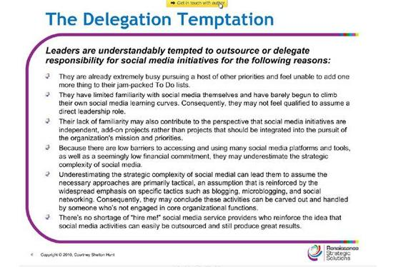
Recommendations for the Design of Slides
Text
no complete texts → concise core statements & keywords
short, simple formulations
Figures, tables, graphics
Not too many numbers → must be discussed
Take the audience with you:
Reduce complexity
Emphasise the important
Specify sources!
http://cdn3.computerworlduk.com/cmsdata/slideshow/3236618/img_081810-bad-powerpoint-10_thumb555.jpg

Slide 17
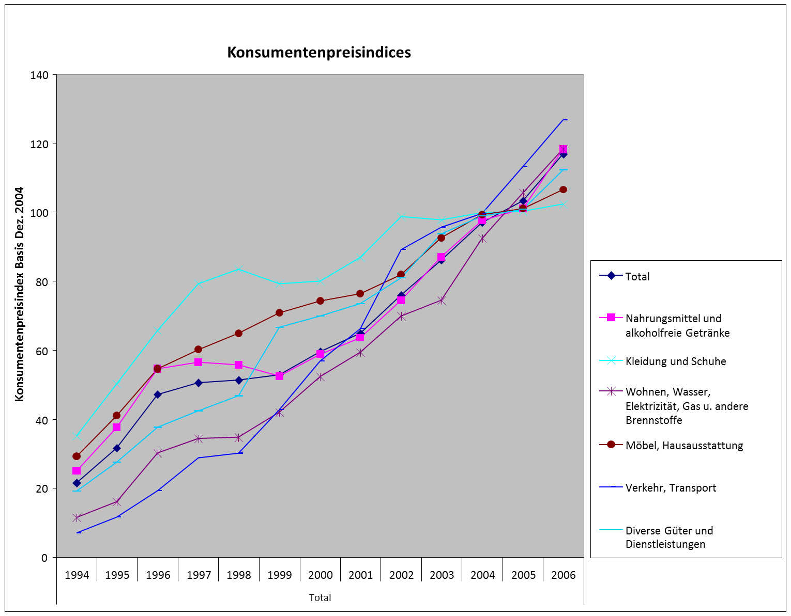
Emphasise Important Points Clearly
Consumer price indices by product group

Slide 18
Emphasise Important Points Clearly
Consumer price indices by product group

Slide 19
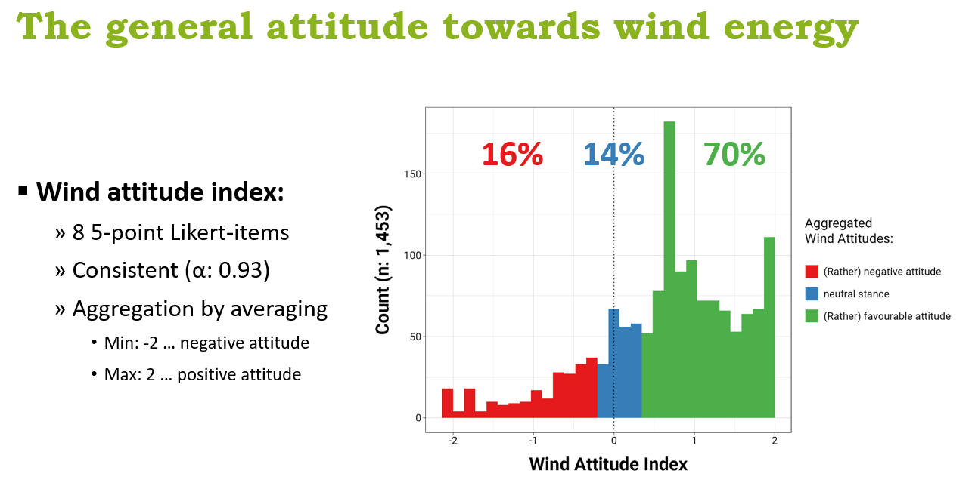
Emphasise Important Points Clearly
(Höferl, 2024)

Slide 20
Recommendations for the Design of Slides
Graphics
need time & explanation
Audience sees graphic for the first time
Build up complex graphics slowly through animation
Specify sources

Slide 21
Recommendations for the Design of Slides
Graphics
need time & explanation
Female listeners may be seeing this graphic for the first time
Build up complex graphics slowly through animation
Specify sources
Photos
Matching the topic of the slide
Not too many small photos 👉 few large images
Specify sources
Orientation
Page numbers, name, topic, event, etc.

Slide 22
Present it!

Slide 23
Preparing, Delivering and Digesting a Talk
1
2
3
4
Preparation of the presentation
(Lehmann 2007:134)

Slide 24
Presenting in Front of an Audience
Directly before the presentation:
Brightness (room & presentation medium)
Test technology (colours, image detail etc.)
Where can I stand 👉 Feel good without disturbing
Clarify moderation
Introduction
Time control
Discussion leader
(Berninger, Botzen & Kolle 2012:190)

Slide 25
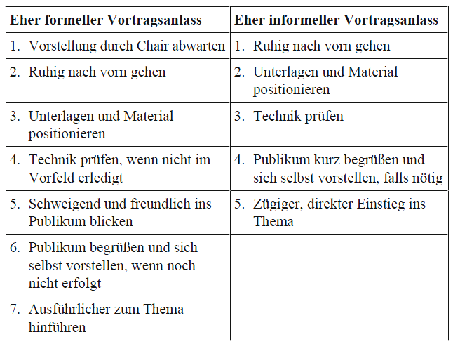
Finding an Entry Point
(Berninger, Botzen & Kolle 2012:190)

Slide 26
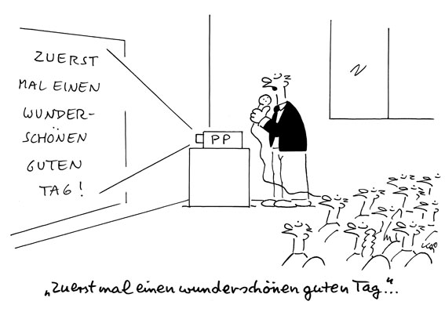
Rhetoric as the Key to Success
What do I say?
How do I say it?
How do I behave when speaking?
"Before we set out to convince others, we must be convinced ourselves." (Dale Carnegie)
👉 Only present familiar content

Slide 27
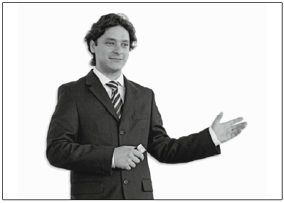
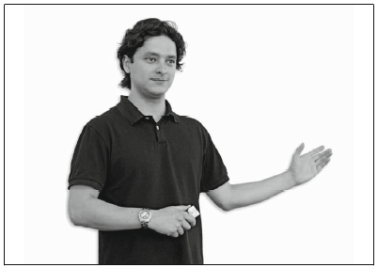
Rhetoric as the Key to Success
Appropriate volume
Speed
Not too fast, but fluid
Breaks 👉 structure & increase attention
Short, simple sentences
Signpost
Remarks where you are standing or
short interim summaries
Dialect
Scientific environment: understandable Hochdeutsch etc.
Depending on the audience & occasion 👉 can appear (un)likeable
(Berninger, Botzen & Kolle 2012:178)

Slide 28
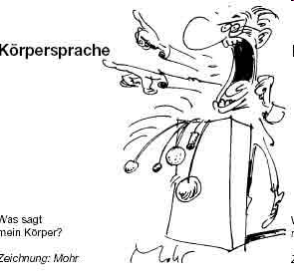
Rhetoric as the Key to Success
Eye contact
Search anchor
Manuscript
verbatim quotes: slowly!
Contact with the screen
Laser pointer or pointer stick
Contact with the screen, body and view of the audience
Posture
Open to the public
As upright as possible
Gestures
Hands not above the shoulder line
(Berninger, Botzen & Kolle 2012:178)

Slide 29
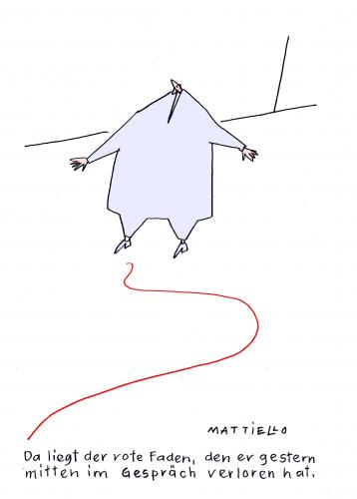
What to do With ...
Slips of the tongue
Incomplete sentences
One word does not come to mind
Losing the common thread
Carry on
Apologise & correct
Listeners do not know the sequence 👉 short pauses do not disturb
Look in the manuscript & summarise what was last said
That's the thread he lost yesterday in the middle of the lecture.

Slide 30

Dealing with Nervousness
Allow sufficient preparation time
View each presentation as an exercise
The topic is important 👉 the rest can still be fine-tuned
Familiarise yourself with the room & devices
Play through the lecture mentally
Rehearsal lecture in front of friends
Be present early enough
→ Loosening & relaxation exercises

Slide 31
And then …

Slide 32
Preparing, Delivering and Digesting a Talk
1
2
3
4
Preparation of the presentation
(Lehmann 2007:134)

Slide 33
Why not a Poster?

Slide 34
Look, Think, Test, Tell
(Sheppard, 2020:5)

Slide 35
... Presentation of Findings I

Slide 36
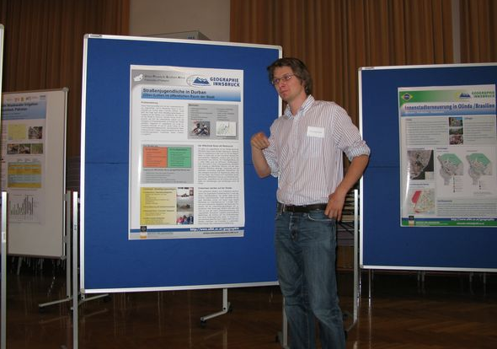
Present Results with Posters
Target:
Content & results concise & quickly recognisable
👉 It must be clear at first glance what it's all about!
Clarify three questions in advance:
The aim of the poster?
Key message?
Target audience?
Choice of terms, complexity of the argumentation

Slide 37
An Example:
(Sartori et al. 2021)

Slide 38
Content Structure of Scientific Posters
Quality of content is prime!
Title = concisely reflect the main message of the poster
Abstract: Overall Summary
Introduction: Aim & question
Methods
Results
Discussion
Possible bibliography
→ Shorten without generalising!

Slide 39
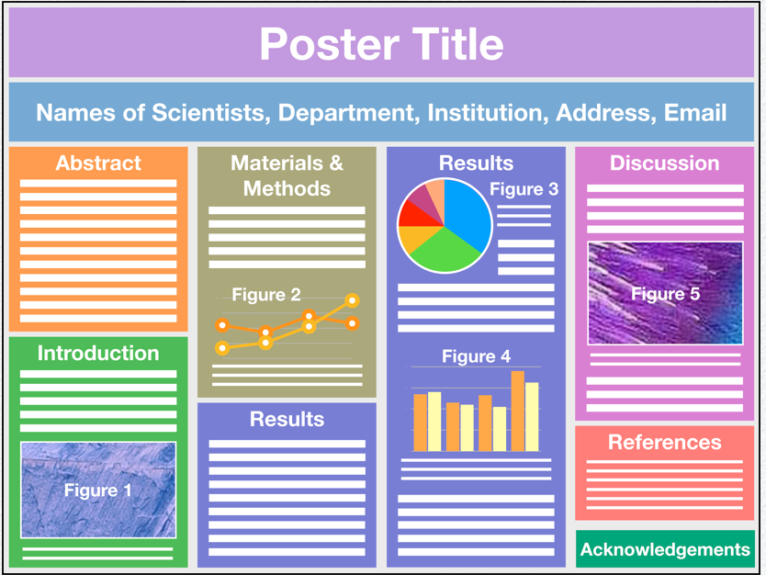
Content Structure of Scientific Posters
(Ohio State University, n.d.)

Slide 40

Content Structure of Scientific Posters
(Ohio State University, n.d.)

Slide 41
Graphical structure of wiss. poster
Varied 👉 arouses interest
Graphics = visualise results
Graphics should speak for themselves
Take layout specifications into account
Note contrasts 👉 Do not distract the background from the content
Headlines visible from at least 5 m
Standardised formatting

Slide 42

Tips & Tricks
Clear content & graphic structure
Title, research question, theory, method, results, discussion (possibly literature)
Clear sequence
Content: few central statements
Balanced mixture Text & illustrations

Slide 43

Tips & Tricks
Graphical structure
Specify reading direction graphically
Line length: not over the entire poster width
Structuring the content into text blocks 👉 Subheadings
Font size
Title clearly legible from 5 metres
Text clearly legible from 1.5 metres
Increase line spacing (BSP: 1.5)
Uniform colour scheme
Few high-contrast colours (background-text)
Labels & quotes

Slide 44

Tips & Tricks
... it's the content that counts ;-)
@Technology:
Design directly in output size
A2, A1 or A0
Plots per PDF
At least 600dpi resolution
CMYK colour mode
Embed fonts
Software:
PPT, Illustrator, Inkscape etc.

